Slide 1
Programming Fundamental
Week 10
Sobia Iftikhar
Sobia.Iftikhar@nu.edu.pk

Slide 2
Class 22

Slide 3
We’ll Learn
Functions: Declaration, Definition and Calling
Passing values to functions, Passing arrays to functions
2. Standard library string functions

Slide 4
Functions
The function contains the set of programming statements enclosed by {}. In other words, we can say that the collection of functions creates a program. The function is also known as procedure or subroutine in other programming languages

Slide 5
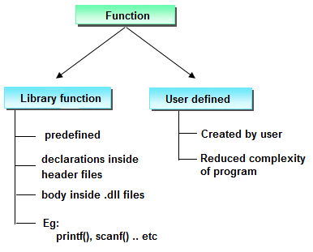
TYPES OF FUNCTIONS IN C PROGRAMMING
Functions Name | Description
Printf() | Print data
Scanf() | Read data
Getchar() | Read a single a character
Sqrt() | Calculate the square
Pow() | Calculate the power
Fopen() | Open the specified file

Slide 6
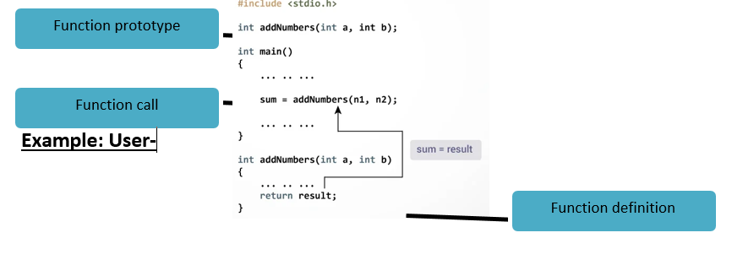
How User-defined Function Works?

Slide 7
Example
Here is an example one to print “Hello pf- students”. To perform this task, a user-defined function printName () is defined.
Here is an example two to add two integer numbers. To perform this task, a user-defined function sum () is defined.
#include<stdio.h>
int sum();
void main()
{
int result;
printf("\n Calculate the sum of two numbers:");
result = sum();
printf("%d",result);
}
int sum()
{
int a,b;
printf("\nEnter two numbers: ");
scanf("%d %d",&a,&b);
return a+b;
}
#include <stdio.h>
void printName ();
void main ()
{
printf("Hello ");
printName();
}
void printName()
{
printf("PF-students");
}

Slide 8
Functions
CALLING A FUNCTION
Control of the program is transferred to the user-defined function by calling it.
SYNTAX OF FUNCTION CALL
functionName (argument1, argument2, ...);
In the above example, function call is made using sum(n1,n2); statement inside the main().
FUNCTION DEFINITION
Function definition contains the block of code to perform a specific task i.e. in this case, adding two numbers and returning it.
SYNTAX OF FUNCTION DEFINITION
returnType functionName(type1 argument1, type2 argument2,
{
//body of the function
}

Slide 9
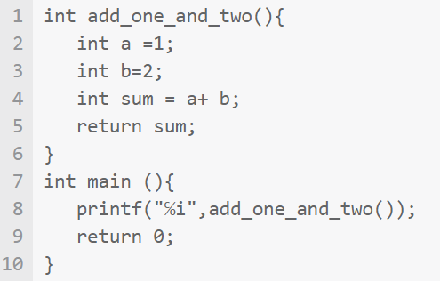
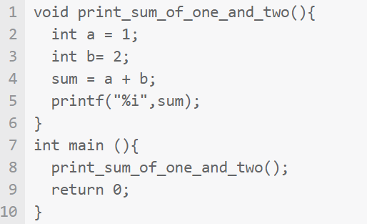
Int vs Void

Slide 10
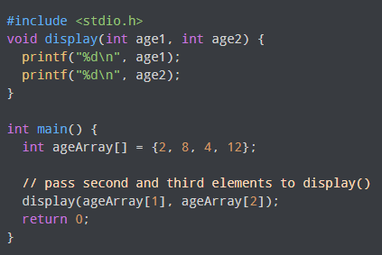
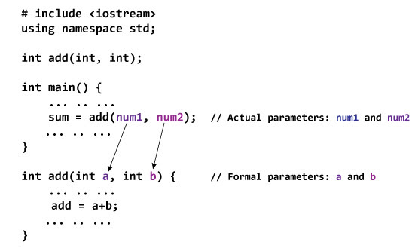
Passing the array as Argument in functions

Slide 11
#include <stdio.h>
float calculateSum(float num[]);
int main() {
float result, num[] = {23.4, 55, 22.6, 3, 40.5, 18};
// num array is passed to calculateSum()
result = calculateSum(num);
printf("Result = %.2f", result);
return 0;
}
float calculateSum(float num[]) {
float sum = 0.0;
for (int i = 0; i < 6; ++i) {
sum += num[i];
}
return sum;
}

Slide 12
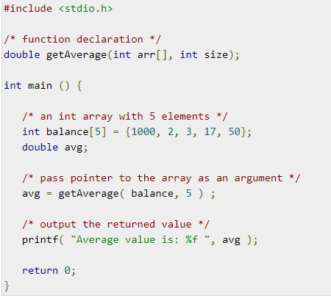
Passing the array as Argument in functions

Slide 13
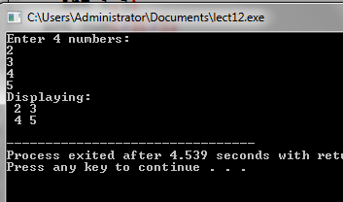
#include <stdio.h>
void displayNumbers(int num[2][2]);
int main() {
int num[2][2];
printf("Enter 4 numbers:\n");
for (int i = 0; i < 2; ++i) {
for (int j = 0; j < 2; ++j) {
scanf("%d", &num[i][j]);
}
}
// pass multi-dimensional array to a function
displayNumbers(num);
return 0;
}
void displayNumbers(int num[2][2]) {
printf("Displaying:\n");
for (int i = 0; i < 2; ++i) {
for (int j = 0; j < 2; ++j) {
printf("%d\n", num[i][j]);
}
}
}

Slide 14
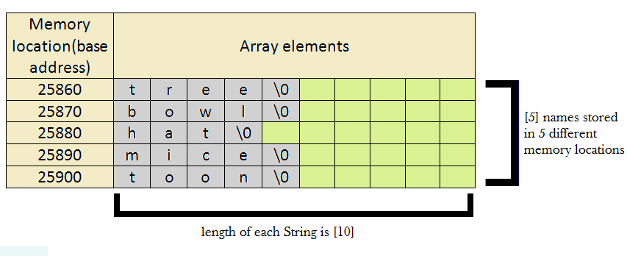
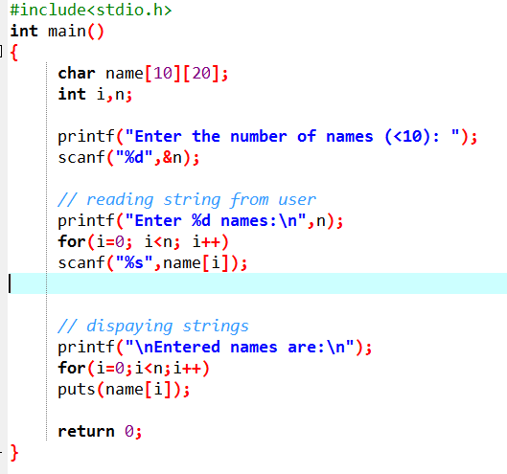
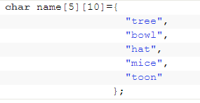
What is 2D character array in C?

Slide 15
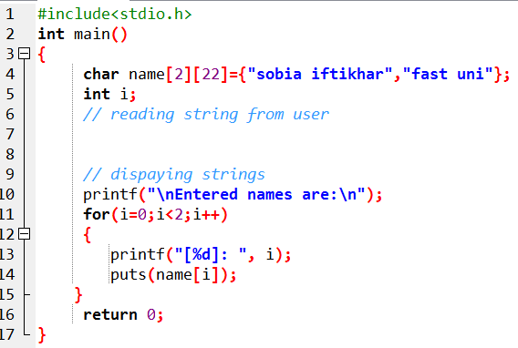
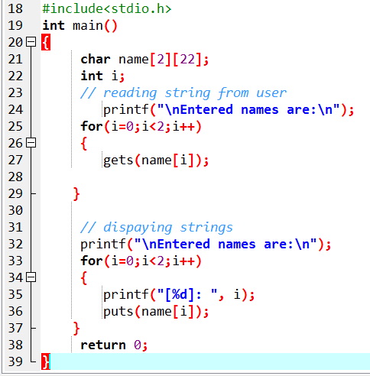

Slide 16
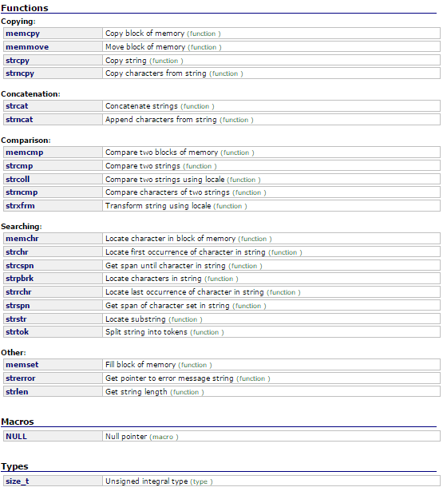
String Functions

Slide 17
strlen function:size_t strlen(const char *str)
#include<stdio.h>
#include<string.h>
int main()
{
char str1[30] = "Programming Fundamentals";
printf("Length of string str1: %d", strlen(str1));
return 0;
}
strlen vs sizeof strlen returns you the length of the string stored in an array, however sizeof returns the total allocated size assigned to the array. So if I consider the above example again, then the following statements would return the below values. strlen(str1) returned value 23. sizeof(str1) would return value 30 as the array size is 30 (see the first statement in main function)

Slide 18
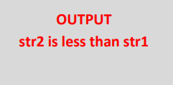
strcmp function: int strcmp(const char *str1, const char *str2)
#include <stdio.h>
#include <string.h>
int main () {
char str1[15];
char str2[15];
int ret;
strcpy(str1, “abcdef");
strcpy(str2, "ABCDEF");
ret = strcmp(str1, str2);
if(ret < 0) {
printf("str1 is less than str2");
} else if(ret > 0) {
printf("str2 is less than str1");
} else {
printf("str1 is equal to str2");
}
return 0;
}
The strcmp() function is used to compare two strings two strings str1 and str2. If two strings are same then strcmp() returns 0, otherwise, it returns a non-zero value.

Slide 19
strncmp function: int strncmp(const char *str1, const char *str2, size_t n)
#include <stdio.h>
#include <string.h>
int main () {
char str1[15];
char str2[15];
int ret;
strcpy(str1, “abcdef");
strcpy(str2, "ABCDEF");
ret = strcmp(str1, str2);
if(ret < 0) {
printf("str1 is less than str2");
} else if(ret > 0) {
printf("str2 is less than str1");
} else {
printf("str1 is equal to str2");
}
return 0;
}
It compares both the string till n characters or in other words it compares first n characters of both the strings

Slide 20
strcat function: char *strcat(char *str1, char *str2)
#include <stdio.h>
#include <string.h>
int main()
{
char s1[10] = "Hello";
char s2[10] = "World";
strcat(s1,s2);
printf("Output string after concatenation: %s", s1);
return 0;
}
strncat function: char *strncat(char *str1, char *str2, int n)

Slide 21
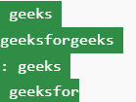
printf("Before strcat() function execution, ");
printf("destination string : %s\n", dest1);
// Appends the entire string of src to dest1
strcat(dest1, src);
// Prints the string
printf("After strcat() function execution, ");
printf("destination string : %s\n", dest1);
printf("Before strncat() function execution, ");
printf("destination string : %s\n", dest2);
// Appends 3 characters from src to dest2
strncat(dest2, src, 3);
// Prints the string
printf("After strncat() function execution, ");
printf("destination string : %s\n", dest2);
return 0;
}
#include <stdio.h>
#include <string.h>
int main(){
// Take any two strings
char src[50] = "forgeeks";
char dest1[50] = "geeks";
char dest2[50] = "geeks";

Slide 22
Thankyou

